Slide 1
Cloud Based Data Engineering
Final Lecture

Slide 2

What is Cloud?
Datacenter hardware and software that the vendors use to offer the
computing resources and services.

Slide 3
3V's of Big Data
Velocity: The data is increasing at a very fast rate. It is estimated that the volume of data will double in every 2 years.
Variety: Data is structured as well as unstructured.
structured – predefined schema
unstructured – each document has different properties
Volume: The amount of data which we deal with is of very large size of Peta bytes.
(1 Peta = 1024 TB)

Slide 4
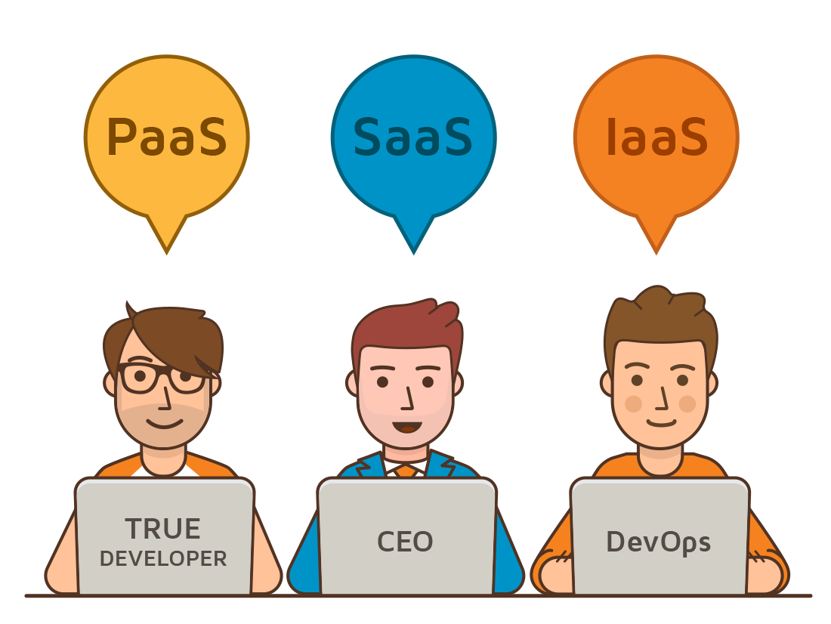
Cloud Computing Services
Software as a Service (SaaS) – applications though the browser
Platform as a Service (PaaS) - Delivery of a computing platform for custom software development as a service
Infrastructure as a Service (IaaS) - Deliver of computer infrastructure as a service
And more ..

Slide 5
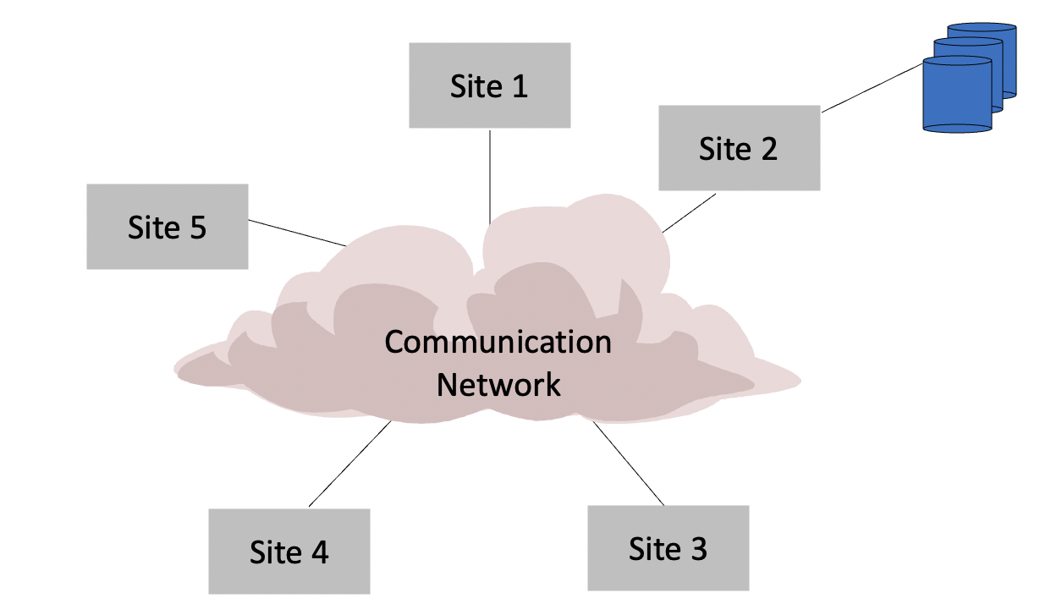
Centralized DBMS

Slide 6
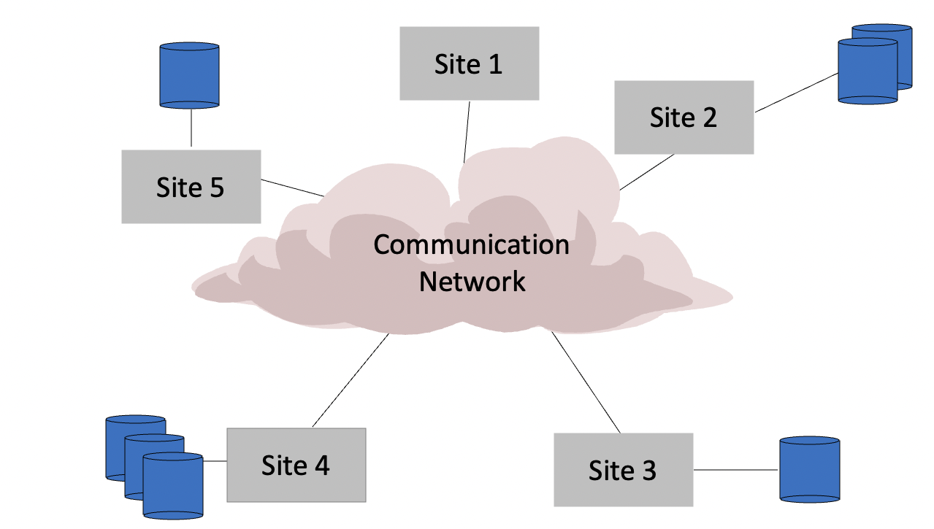
Distributed DBMS

Slide 7
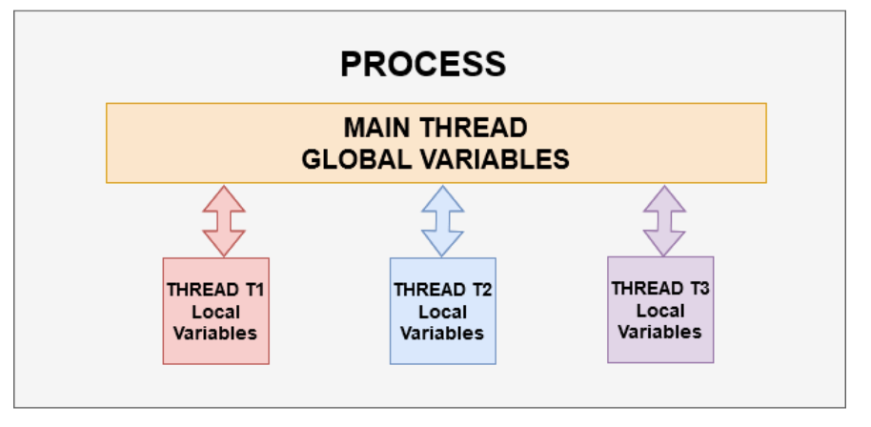
Parallel Computation
Threading allows you to have different parts of your process run concurrently. For example, A web-browser could be a process, an application running multiple cameras simultaneously could be a process.
multiple threads work together to achieve a common goal

Slide 8
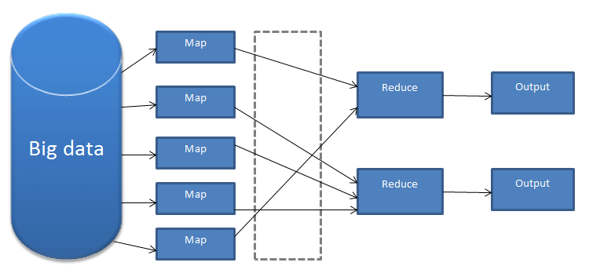
MapReduce - How Is It Work?
The reduce task is always performed after the map job.

Slide 9

HADOOP
Hadoop runs applications using the MapReduce algorithm, where the data is processed in parallel with others.
Hadoop is used to develop applications that could perform complete statistical analysis on huge amounts of data.

Slide 10
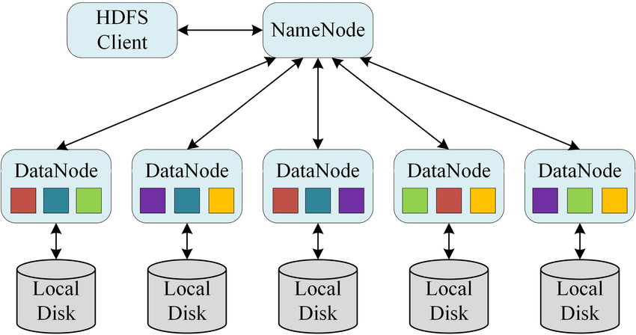
HDFS
The Hadoop Distributed File System (HDFS) is based on the Google File System (GFS) and provides a distributed file system that is designed to run on commodity hardware. It has many similarities with existing distributed file systems.

Slide 11
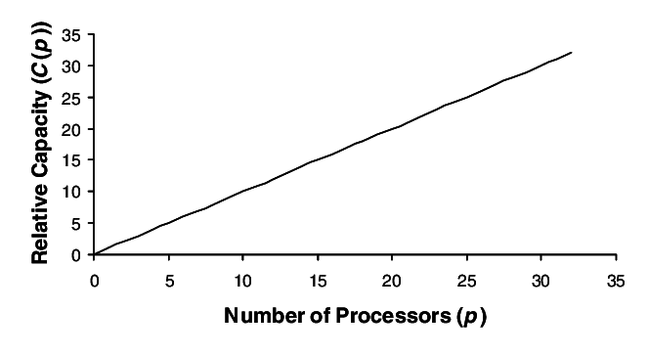
Hadoop – Linear Scalability
If you have twice as many computers, jobs run twice faster
If you have twice as much data, jobs run twice slower
If you have twice as many computers, you can store twice as much data!

Slide 12

Terminology
$$TF\left(t,d\right)=\frac{count of t in d}{number of words in d}$$
$$DF\left(t\right)=occurrence of t in N documents$$
$$IDF\left(t\right)=\log\left(\frac{N}{DF\left(t\right)}\right)$$
$$TF−IDF\left(t,d\right)=TF\left(t,d\right)⋅\log\left(\frac{N}{DF\left(t\right)}\right)$$
TF-IDF = Term Frequency (TF) * Inverse Document Frequency (IDF)

Slide 13
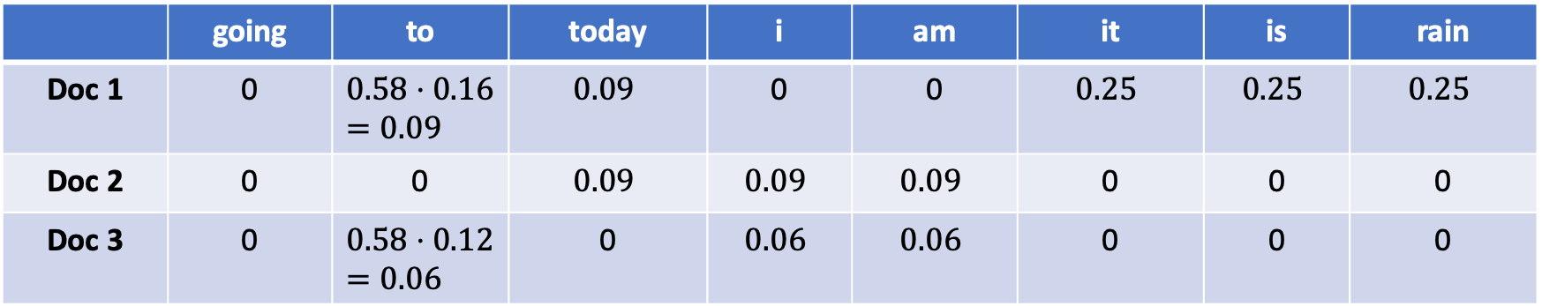
Example
Step 4: Find TF-IDF
“it”, “is”, “rain” important for doc1 but not for docs 2 and 3.
Docs 1 and 2 talks about today
 | going | to | today | i | am | it | is | rain
Doc 1 | 0 | $$0.58⋅0.16=0.09$$ | $$0.09$$ | 0 | 0 | $$0.25$$ | $$0.25$$ | $$0.25$$
Doc 2 | 0 | 0 | $$0.09$$ | $$0.09$$ | $$0.09$$ | 0 | 0 | 0
Doc 3 | 0 | $$0.58⋅0.12=0.06$$ | 0 | $$0.06$$ | $$0.06$$ | 0 | 0 | 0

Slide 14

Spark
Apache Spark is a fast and general-purpose cluster computing system.
Provides high-level APIs in Java, Scala, Python and R.
Optimize engine that supports general execution graphs.
Can manage "big data" collections with a small set of high-level primitives like map, filter, group-by, and join.
Supports a rich set of higher-level tools including Spark SQL.

Slide 15
Gray sort competition: Winner
 | Hadoop MR Record | Spark Record (2014)
Data Size | 102.5 TB | 100 TB
Elapsed Time | 72 mins | 23 mins
# Nodes | 2100 | 206
# Cores | 50400 physical | 6592 virtualized
Cluster disk throughput | 3150 GB/s (est.) | 618 GB/s
Network | dedicated data center, 10Gbps | virtualized (EC2) 10Gbps network
Sort rate | 1.42 TB/min | 4.27 TB/min
Sort rate/node | 0.67 GB/min | 20.7 GB/min
Sort benchmark, Daytona Gray: sort of 100 TB of data (1 trillion records)

Slide 16
Basic Stream Data Model
Given sequence of elements from some domain:
$$<x_{1},x_{2},x_{3},…>$$
Data is read sequentially in one pass
Bounded storage - limited in the size of working memory
Fast processing time per stream element
We want to create and maintain a sketch which allows us to obtain good estimates of properties

Slide 17
Approximation and Randomization
More generally,
Approximation: find an answer correct within a (1± ε) factor approximation
Randomization: allow a small probability of failure / success probability (1-δ)
Here we want to develop Approximation and Randomization algorithms,
called (ε, δ)-approximations.

Slide 18

Morris’s Algorithm
Idea: Track logn intead of n, use log(logn) bits instead of logn bits.
Claim: $E\left[2^{X}\right]=n+1$
Proof: Induction (not here)
Claim: $V\left[2^{X}\right]=n^{2}$
Proof: not here
Initialize X = 0
When an item arrives, increase X by 1 with probability $\frac{1}{2^{X}}$
When the stream is over, output our estimate $2^{X}−1$

Slide 19
Morris’s Algorithm – Beta Version
Idea: instead of 1 counter, maintain $s$ counters and average their results.
Initialize each $X_{i}$ = 0
When an item arrives, increase each $X_{i}$ by 1 independently with probability $\frac{1}{2^{X_{i}}}$
When the stream is over, output our estimate $\frac{1}{s}⋅\sum{{(2}^{X_{i}}−1)}$

Slide 20
Distinct Elements: Approximate Counting
32,
12,
14,
32,
7,
12,
32,
7,
6,
12,
4,
Size-estimation/Minimum value technique:[Flajolet-Martin 1985]
Let $h(x)$ be a hash function
For each element a in the stream
Find h(a) in binary form
Count the number of trailing zeros
Return $2^{Max−Count}$

Slide 21
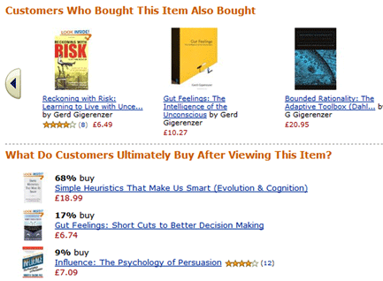
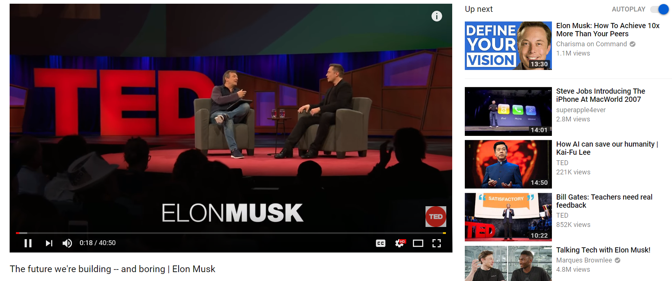
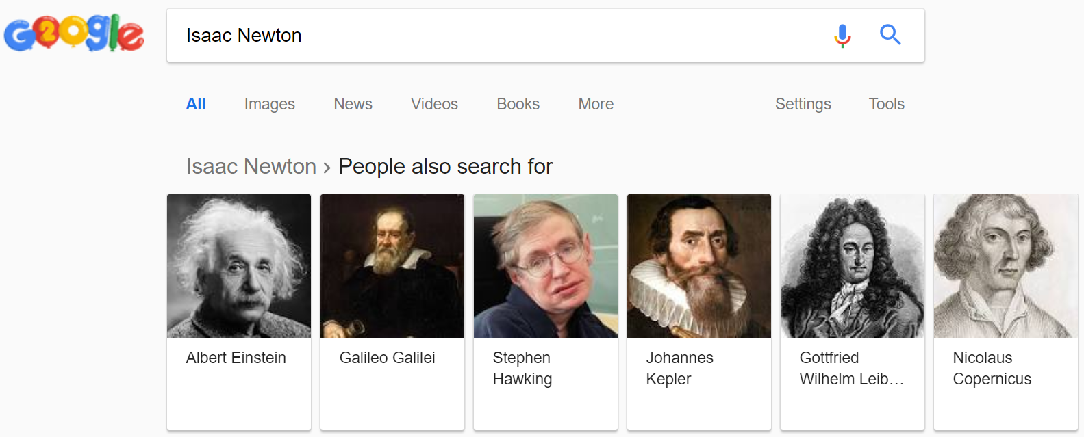
Recommender Systems
A recommender system (RS) helps users that have no sufficient competence or time to evaluate the, potentially overwhelming, number of alternatives offered by a web site. In their simplest form, RSs recommend to their users personalized and ranked lists of items

Slide 22
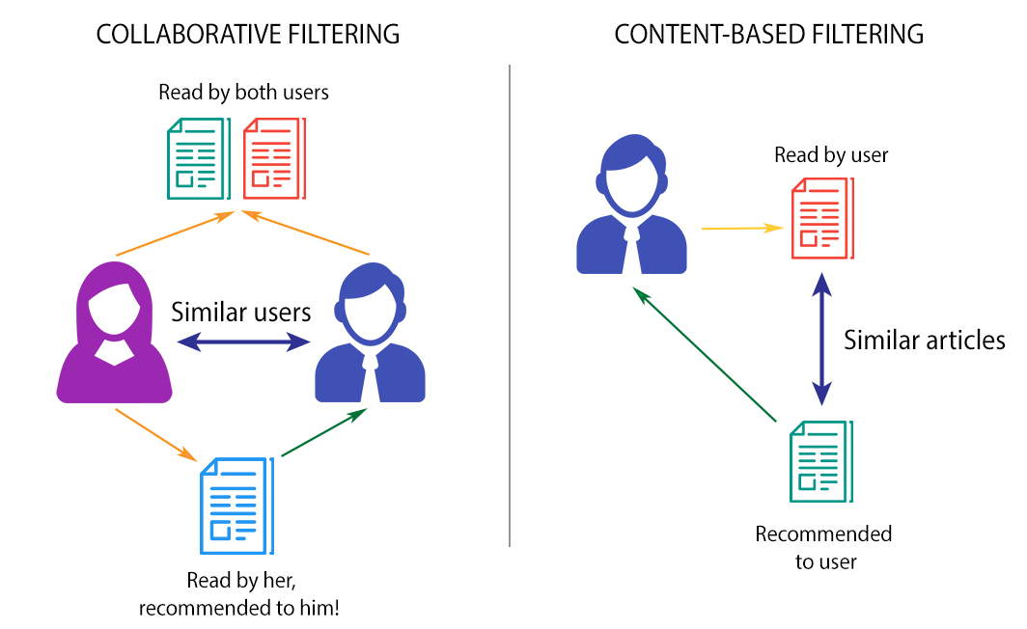
Approaches
Collaborative filtering approach builds a model from a user’s past behaviors (items previously purchased or selected and/or numerical ratings given to those items) as well as similar decisions made by other users.
This model is then used to predict items (or ratings for items) that the user may have an interest in.

Slide 23
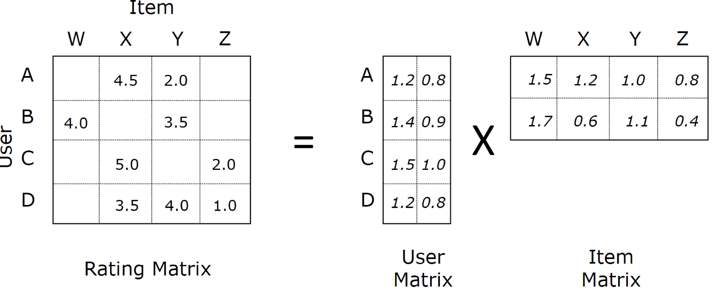
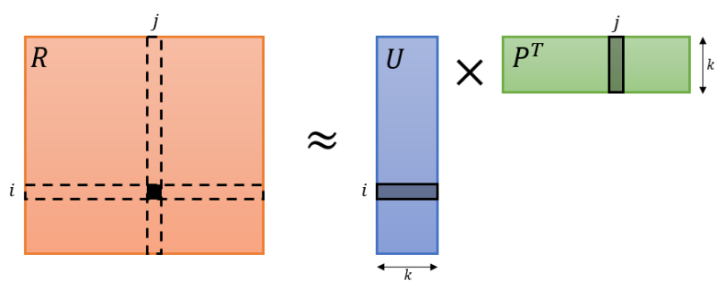
Matrix Factorization
Given matrix $R$ of ratings, factorize it into two matrices $U$ and $P$ such that $U^{T}P ≈R$.
(some versions are $UP^{T} ≈R$)

Slide 24
How to Build Collaborative Filtering using ALS?
Step 1: Load data
Step 2: Split data into train, validation and test sets.
Train - The sample of data used to fit the model.
Validation - The evaluation becomes more biased as skill on the validation dataset is incorporated into the model configuration. (“semi-testing” your model)
Test - The sample of data used to provide an unbiased evaluation of a final model fit on the training dataset.

Slide 25
How to Build Collaborative Filtering using ALS?
Step 3: ALS Model Selection
To find the optimal hyperparameters, use grid search and select the best model.
Step 4: Learning Curve
As we increased number of iterations in training ALS, we can see how RMSE changes and whether model is overfitted. Step 5: Make recommendations ☺

Slide 26
Final Assignment

Slide 27
Instructions
1. There are 4 questions, each group should submit an individual solution.
2. Do your best to handle the homework by yourself.
3. You can use as many as mappers and reducers as you need / want.
4. Submit a PDF for the theoretical questions and jupyter notebook to the rest.

Slide 28
Q1 – Naïve MapReduce
Attached a folder of text files called “genome”. The union of the files is a human DNA sequence. Implement a map-reduce algorithm that gets as an input the above text files and return the distribution (how many times each term appears) of the following terms:
CTC, AAGC, GTT
Design a map-reduce algorithm to solve the problem.
Create dna_mapper.py and dna_reducer.py files and implement the solution.
Test your map-reduce algorithm by running the pipeline commands.
Store your output in a text file.
Attached the file to your submission under the name “dna_distribution.txt”.

Slide 29
Q2 – Hadoop
Use the “Friends” episodes dataset and implement a map-reduce algorithm to find the distribution of “oh-my-god”. Your output should be a list of (key,value) where the key is the character name (ross, chandler, jenice, …) and the value is the “oh-my-god” count.
Note: be aware that the phrase may appear as “OMG”, “oh-my-god”, “oh my god” and more.

Slide 30
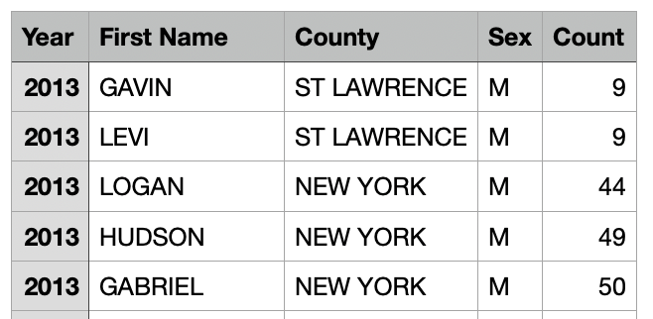
Q3 – Spark
Attached a csv file called “baby_names.csv”. The file has the following format:
Year, First Name, Country, Sex, Count
Each row present newborn children and their name, country, gender, and total count.

Slide 31
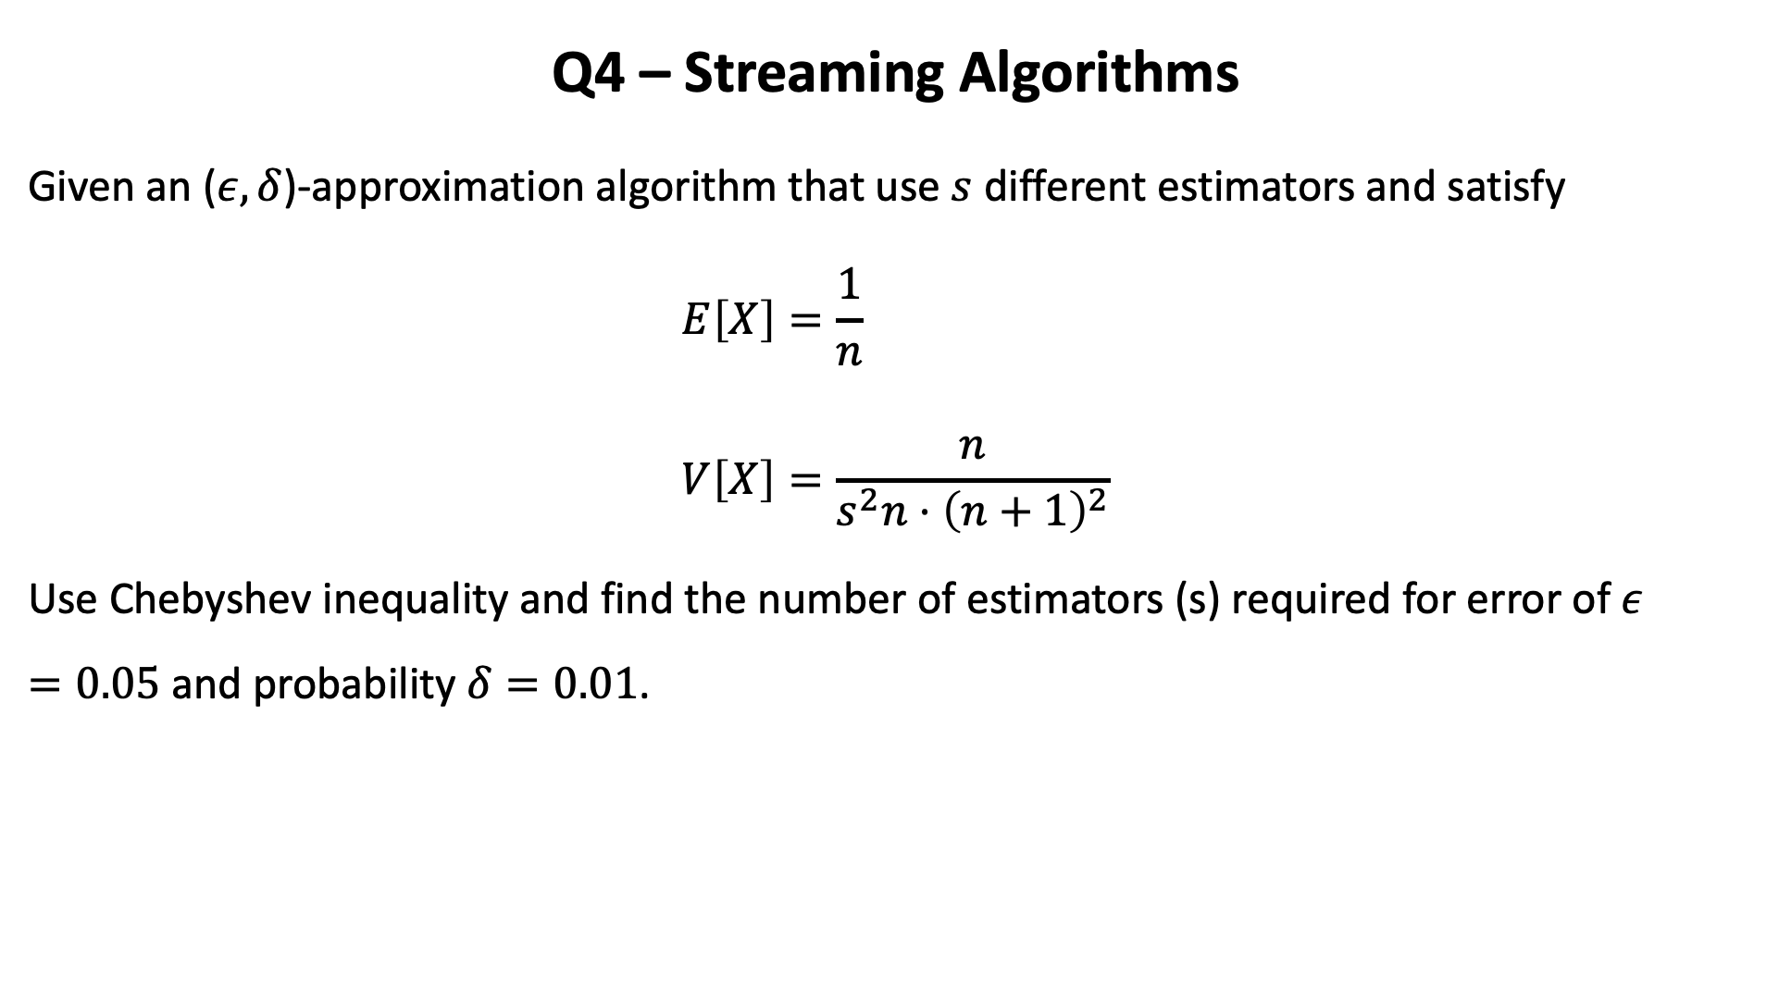
Q4 – Streaming Algorithms
Given an ($ε,δ$)-approximation algorithm that use $s$ different estimators and satisfy
$$E\left[X\right]=\frac{1}{n} \\ V\left[X\right]=\frac{n}{s^{2}n⋅{\left(n+1\right)}^{2}}$$
Use Chebyshev inequality and find the number of estimators (s) required for error of $ε=0.05$ and probability $δ=0.01$.

Slide 32

Q4 – Streaming Algorithms
Given a matrix $R$ with rows are Users and columns are Products:
$$R=\left(\begin{matrix}3 & x & 2 \\ 5 & 1 & 3\end{matrix}\right)$$
Simulate ALS and find approximation for $x$.

Slide 33
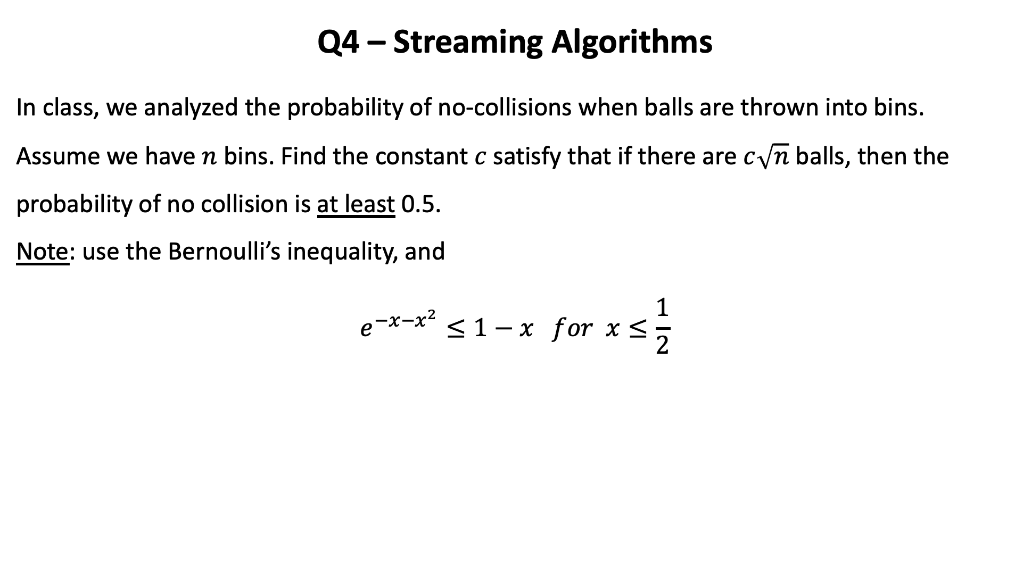
Q4 – Streaming Algorithms
In class, we analyzed the probability of no-collisions when balls are thrown into bins. Assume we have $n$ bins. Find the constant $c$ satisfy that if there are $c\sqrt{n}$ balls, then the probability of no collision is at least 0.5. Note: use the Bernoulli’s inequality, and
$$e^{−x−x^{2}}≤1−x for x≤\frac{1}{2}$$

